Slide 1
Marching Cube
http://paulbourke.net/geometry/polygonise/

Slide 2
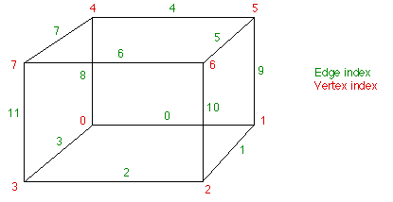
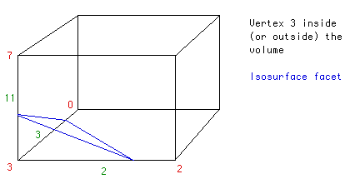
Model

Slide 3
Cube Index
cubeindex = 0;
if (g.val[0] < iso) cubeindex |= 1;
if (g.val[1] < iso) cubeindex |= 2;
if (g.val[2] < iso) cubeindex |= 4;
if (g.val[3] < iso) cubeindex |= 8;
if (g.val[4] < iso) cubeindex |= 16;
if (g.val[5] < iso) cubeindex |= 32;
if (g.val[6] < iso) cubeindex |= 64;
if (g.val[7] < iso) cubeindex |= 128;

Slide 4
Cube Index->EdgeTable<->TriTable
Iso surface cut a cell
8:vertex Number, 2^1:iso above or below vertex value.
12:Edge
Cube index:2^8,
Edge index:0-12
EdgeTable 12bit
TriTable :vertex id table
E.g.:
iso above vertex 3, cube index=0000,0100=8
EdgeTable [8]=0x80c= 1000 0000 1100b=11,3,2bit(vertex) valid
triTable[8]= {3, 11, 2, -1, -1, -1, -1, -1, -1, -1, -1, -1, -1, -1, -1, -1},

Slide 5
VertexInterpolation
P = P₁ + (isovalue - V₁) (P₂ - P₁) / (V₂ - V₁)
XYZ VertexInterp(double isolevel, XYZ p1, XYZ p2, double valp1, double valp2) {
double mu;
XYZ p;
if (ABS(isolevel - valp1) < 0.00001)
return (p1);
if (ABS(isolevel - valp2) < 0.00001)
return (p2);
if (ABS(valp1 - valp2) < 0.00001)
return (p1);
mu = (isolevel - valp1) / (valp2 - valp1);
//mu = 0.5;
p.x = p1.x + mu * (p2.x - p1.x);
p.y = p1.y + mu * (p2.y - p1.y);
p.z = p1.z + mu * (p2.z - p1.z);
return (p);
}

